Slide 1
VCF MANIPULATION
Finishing your VCF
JOSE DE VEGA
jose.devega@earlham.ac.uk

Slide 2
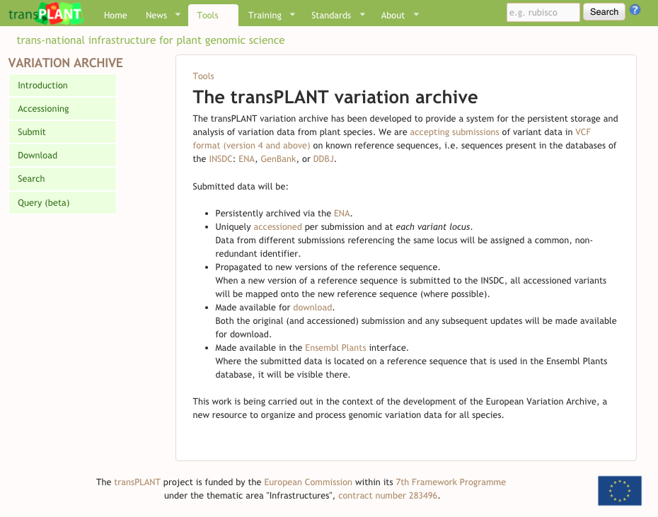
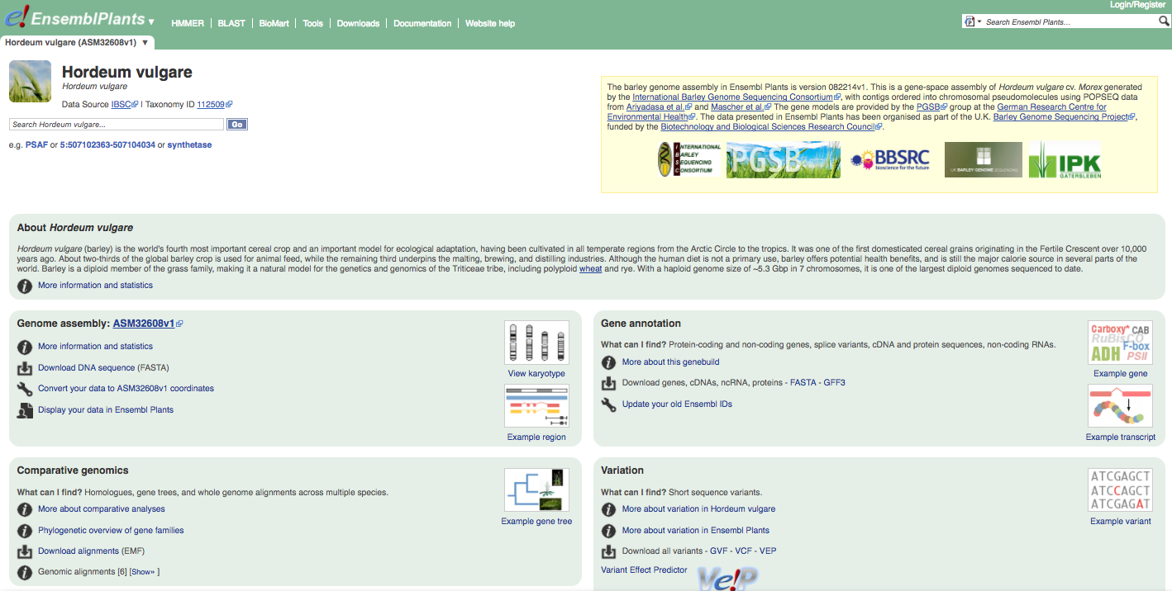
Finding data about variation
http://plants.ensembl.org/Hordeum_vulgare/Info/Index
http://www.transplantdb.eu/variation/intro
http://www.transplantdb.eu/training-resources

Slide 3
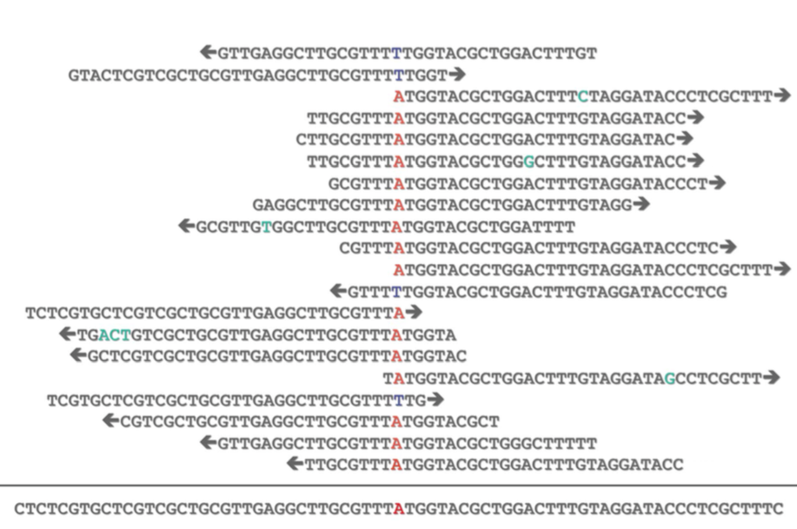
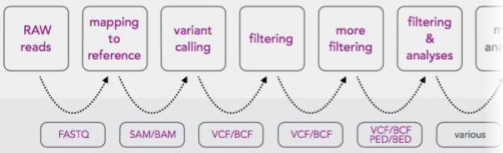
A “more real” SNP calling pipeline
VCF
BCF
PED
BED

Slide 4
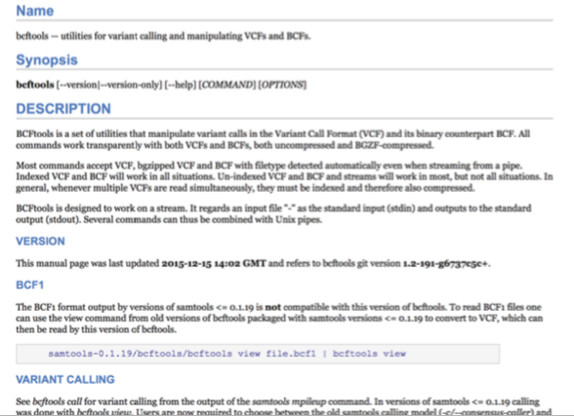
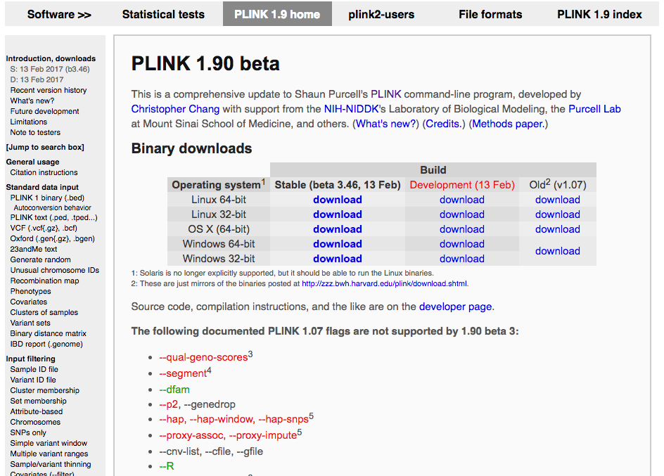
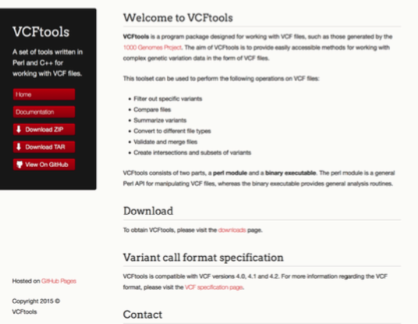
VCFtools, BCFtools & PLINK
The new PLINK 1.9 can also be used with genomic data of non-model organisms.

Slide 5
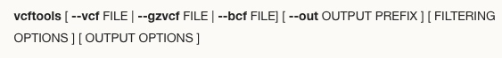
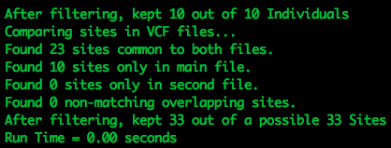
VCFtools filtering exercise
The order is important, check the help: vcftools --help
Task 1: Compare the two files produced in the previous exercise:
vcftools --vcf SNPs_defaults.vcf --diff SNPs_prefiltered.vcf --maf 0.1 --diff-site
How many differences are there? These are very small files, we can check it manually opening them side-to-side. Eg: vimdiff SNPs_defaults.vcf SNPs_prefiltered.vcf
Task 2: Playing more with the filtering…
SORT THE FILE, also remove all indels, any site with a FILTER flag other than PASS, and with a min. allele freq under 0.1
cat SNPs_defaults.vcf | vcf-sort | vcftools --vcf - --out playingmore --remove-indels --remove-filtered-all –-recode
vcftools --vcf SNPs_defaults.vcf --diff playingmore.recode.vcf --diff-site

Slide 6
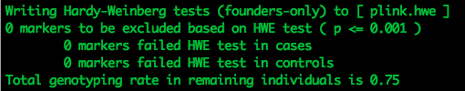
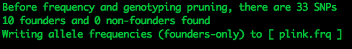
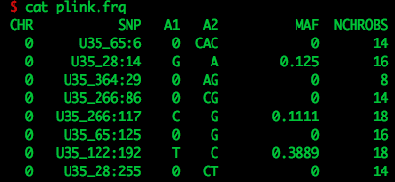
PLINK exercise
There are two standard file types for PLINK: ped and map files
• Ped files contain information about the family, phenotype and genotype
• Map files contain information about the genetic markers
Task 1: A quick analysis with PLINK
Go into the folder with the data and list the content: cd devega_plink_linux_x86_64; ls
plink --noweb --file toy --hardy
Task 2: Import the VCF file from the previous exercise, and perform another analysis
vcftools --vcf SNPs_defaults.vcf --plink --out SNPs_defaults
plink --noweb --file SNPs_defaults –freq

Slide 7
PLINK “homework“
You may want to use the slurm remote server for this more complex analysis (ssh)
Check that you have the ”Tutorial_Matrix” files in the folder devega_plink_linux_x86_64

